Slide 1
Shopping Cart Program
PRESENTED BY GROUP 8
Members
Abdulmoueed 233536
Rayyan 233534
ALwaz 233590

Slide 2
User Class Overview
1. The `User` class manages user details and allows for user creation, login, and file persistence.
2. It stores essential user information such as name, email, password, phone number, and age.
3. The class enables seamless login and sign-up operations to manage user sessions.

Slide 3
User Class Functions
1. **Constructor**: Initializes user details with name, email, password, etc.
2. **ToString()**: Converts user data into a comma-separated string format for file storage.
3. **SaveUser()**: Writes new user information to 'users.txt' for persistence.
4. **LoadUsers()**: Reads user details from the file and loads them into the system.

Slide 4
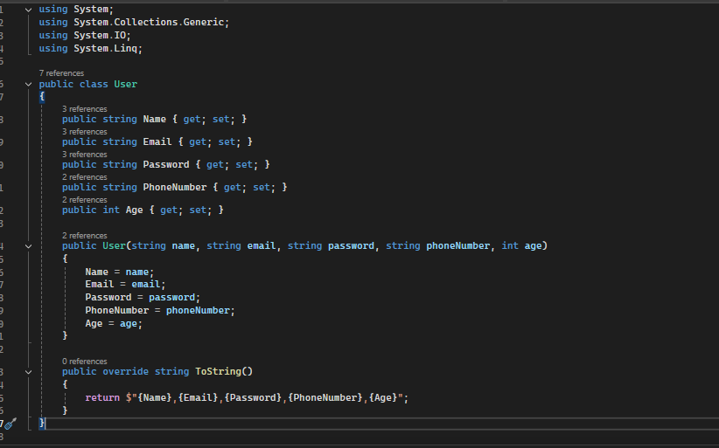

Slide 5
Product Class Overview
1. The `Product` class manages product-related information such as name, price, and stock.
2. Products are categorized under specific categories (Electronics, Clothing, etc.).

Slide 6
Product Class Functions
1. **Constructor**: Initializes the product’s name, price, discount, and available quantity.
2. **GetDiscountedPrice()**: Calculates the price after applying the product discount.
3. This class serves as the core for handling product details in the shop categories.

Slide 7
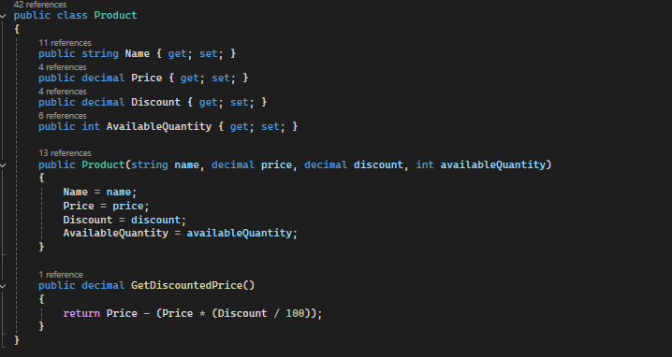

Slide 8
Shop Class Overview
1. The `Shop` class represents a store with different product categories.
2. Categories include various types of products, such as Electronics, Clothing, Footwear, and more.
3. Each shop can have multiple categories, allowing the system to simulate multiple stores.

Slide 9
Shop Class Functions
1. **Constructor**: Initializes empty lists for each product category.
2. **LoadShops()**: Populates sample shops and their products for the simulation.
3. This class organizes products under relevant categories for ease of shopping.

Slide 10
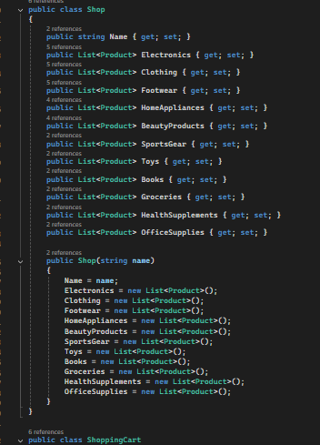

Slide 11
ShoppingCart Class Overview
1. The `ShoppingCart` class allows users to manage products they wish to purchase.
2. It tracks the quantity of products added, removed, and calculates the total cost of items.

Slide 12
ShoppingCart Class Functions
1. **AddProduct()**: Adds selected products to the cart while checking for stock availability.
2. **RemoveProduct()**: Removes products from the cart and adjusts available stock.
3. **ViewCart()**: Displays the contents of the cart and the total price including tax.
4. **IsExpired()**: Checks if the cart has expired after a 30-minute inactivity window.

Slide 13
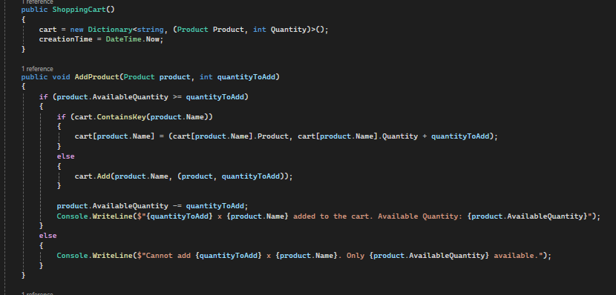

Slide 14
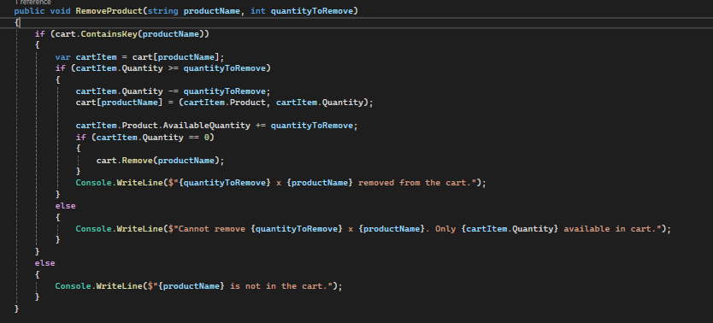

Slide 15
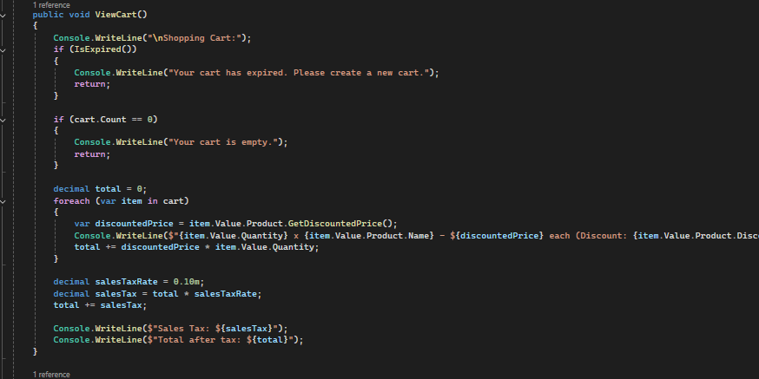

Slide 16
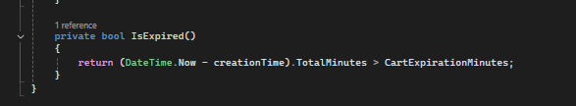

Slide 17
Main Method Overview
1. The `Main` method controls the flow of the program, handling user inputs and interactions.
2. Users are prompted to either sign-up, log in, or exit the system based on their inputs.

Slide 18
Switch-Case Functionality
1. Switch-case manages user options, such as viewing products, adding items to the cart, or logging out.
2. Each case in the switch statement corresponds to a different user operation.
3. The default case handles invalid inputs and guides the user to enter a valid option.

Slide 19
Main Method: In-Depth Breakdown
1. **SignUp()**: Collects user data and saves it to the 'users.txt' file.
2. **LogIn()**: Verifies user credentials from the 'users.txt' file and grants access if valid.
3. **UserMenu()**: Provides options for users to add, remove, or view items in their shopping cart.
4. Handles continuous user input in a loop to keep the program running unless the user logs out.

Slide 20
File Handling in Main Method
1. The program uses text file ('users.txt') to store and retrieve user data for persistence.
2. **LoadUsers()**: Reads the file to populate the user list when the program starts.
3. **SaveUser()**: Writes new user data to the file to retain information across sessions.
4. Error handling can be added to manage file corruption or missing files.

Slide 21
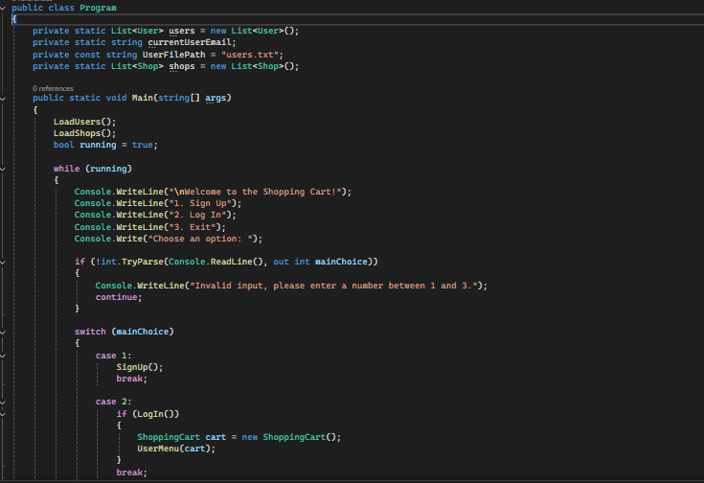

Slide 22
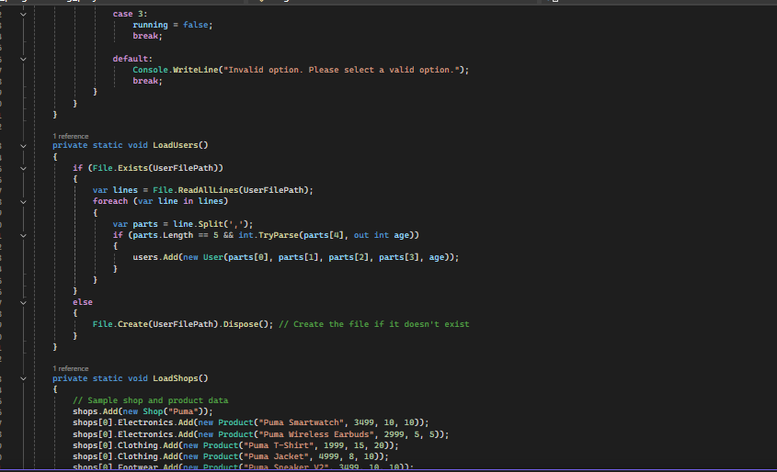

Slide 23
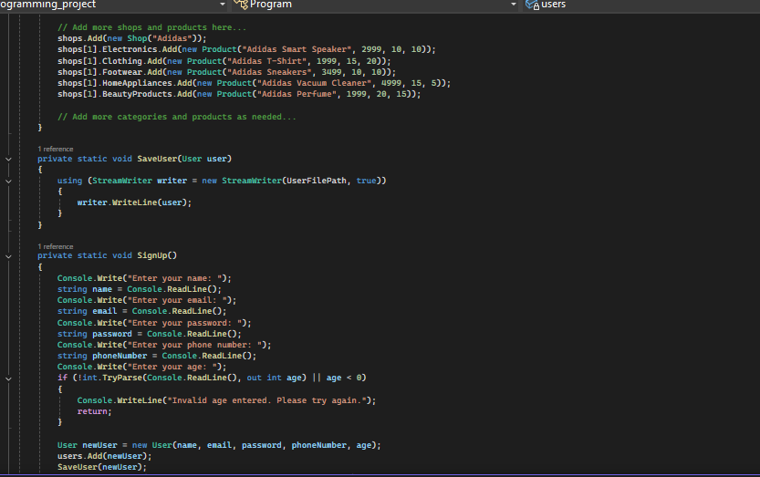

Slide 24
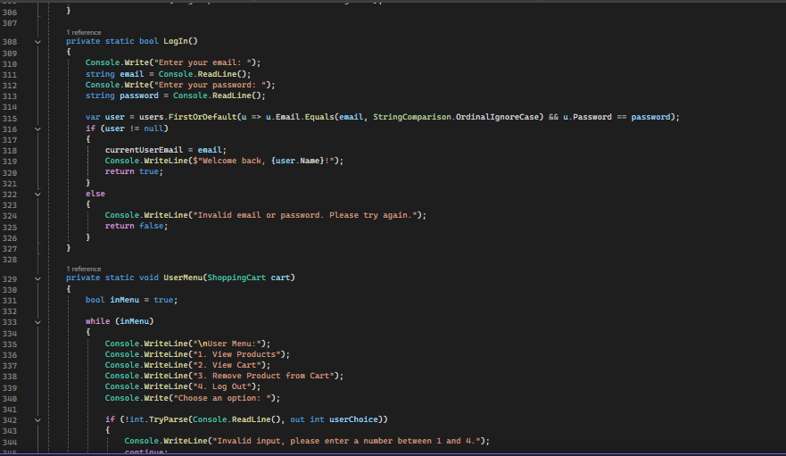

Slide 25
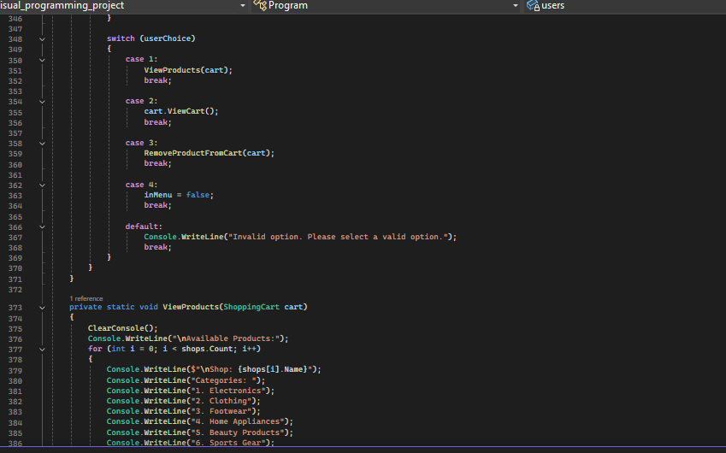

Slide 26
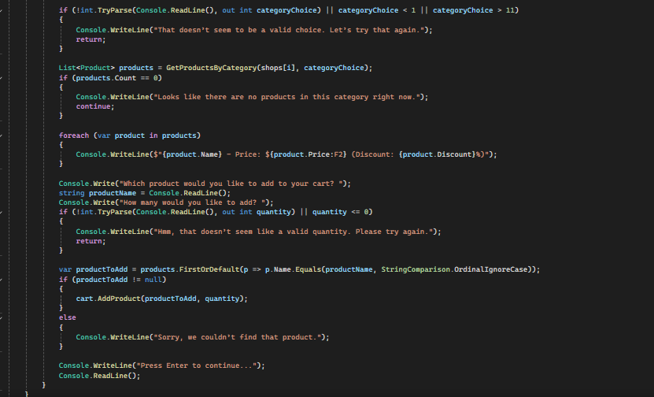

Slide 27
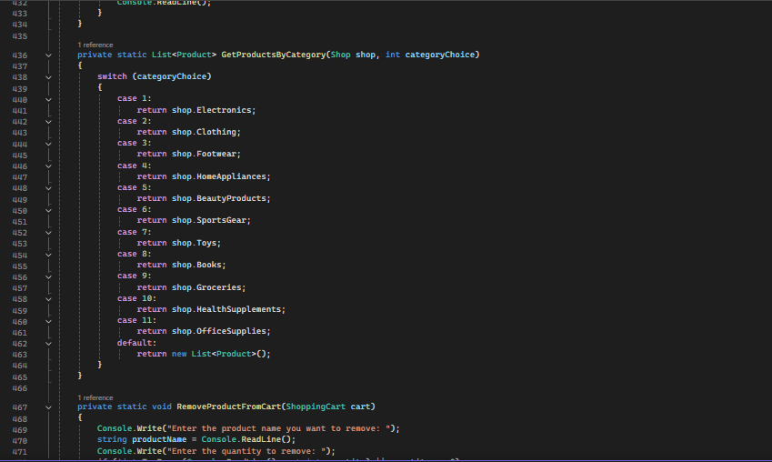

Slide 28
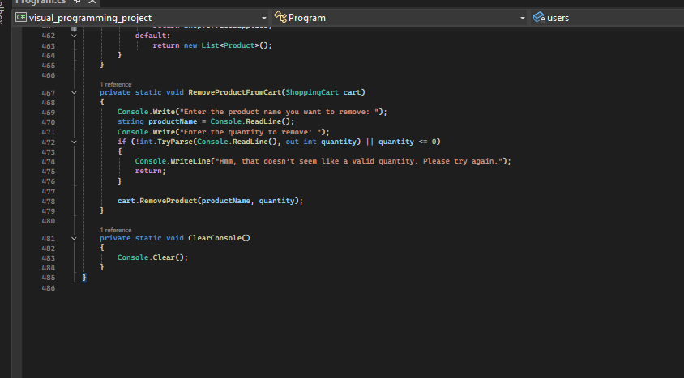

Slide 29
Conclusion
1. This shopping cart program demonstrates an e-commerce system using object-oriented principles.

Slide 30
Conclusion
1. This shopping cart program demonstrates an e-commerce system using object-oriented principles.
2. It integrates essential features like user sign-up, login, product management, and cart handling.
3. The program utilizes file handling for user persistence and ensures data retention across sessions.
4. Future improvements can include a checkout process, payment integration, and product filtering.

